Slide 1
Riordan Security Planning
Team C CMGT 430: Enterprise Security University of Phoenix August 8th, 2014

Slide 2
Physical Vulnerabilities
Jennah Slide One

Slide 3
Physical Vulnerabilities
Jennah Slide Two

Slide 4
Logical Vulnerabilities
Darnell Slide One

Slide 5
Logical Vulnerabilities
Darnell Slide Two

Slide 6
Other Vulnerabilities/Threats
Unpatched Systems
Public endpoints
Insecure deployments
Malware infected devices

Slide 7
Critical vulnerabilities and recommended mitigation techniques
Vulnerability
No printer threshold
Web server bugs
Web server traffic limits
Risks
Delayed productivity
Mitigation Technique
Authentication method
including username/password
Website repairs/
reputational risk
Validation and latest software
version
Website repairs/ reputational risk
QoS traffic/packet shapers

Slide 8
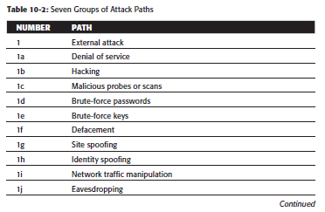
Virtualization Compliance
Section 1 of attack paths for any organization
Attack path analysis
Compliance requirements check list
Can custom-fit any organization

Slide 9
Conclusions
Ryan slide one

Slide 10
References
Everyone add links here

